Slide 1


Predicting the Number of Ozone Exceedance Days for National Parks with Monitoring Sites
Gillian Tatreau
Department of Data Science, Bellevue University
DSC680: Applied Data Science
Amirfarrokh Iranitalab
7 January 2024

Slide 2

What is an ozone exceedance day?
Ozone is a pollutant and major component of smog.
An ozone exceedance day occurs when the daily maximum 8-hour average is greater than or equal to 71 ppb.
Increase in the amount of ozone poses possible dangers to both the ecosystem and the people in the parks

Slide 3
Research Questions
Is the number of ozone exceedance days increasing for all monitored sites, and where is the problem the most severe?
Is there a relationship in the data between national parks with monitoring sites? And if so, is this relationship regional, based on number of visitors to the park, the dominant ecosystem of the site (desert versus forest), or something else entirely?
Can predictions for the daily maximum 8-hour average ozone concentration be calculated for each site as well as the number of ozone exceedance days per year?
Does the data support predictions for the number of ozone exceedance days and for the daily maximum 8-hour average ozone concentration that generalize to the entirety of the national park system, or does this data only support predictions for the monitoring sites?

Slide 4

Data
The data comes from the National Park Service
Data preparation
Remove extra months
Column names uniformly formatted
Add year
Add Site ID

Slide 5
Methods
Graphical analysis and statistics (EDA)
ARIMA modeling techniques

Slide 6

Analysis
72 unique Site IDs
4 sites occur every year
8 sites frequent the top 5 number of ozone exceedance days per year

Slide 7
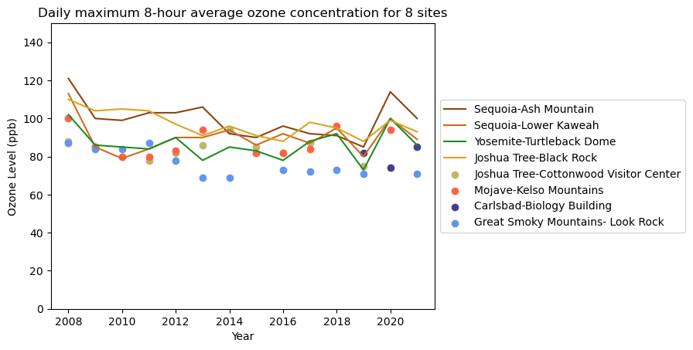
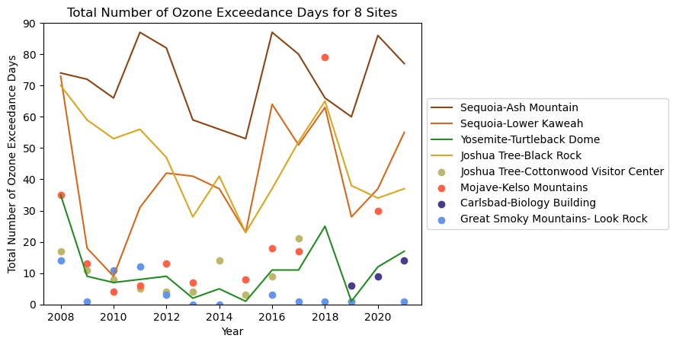
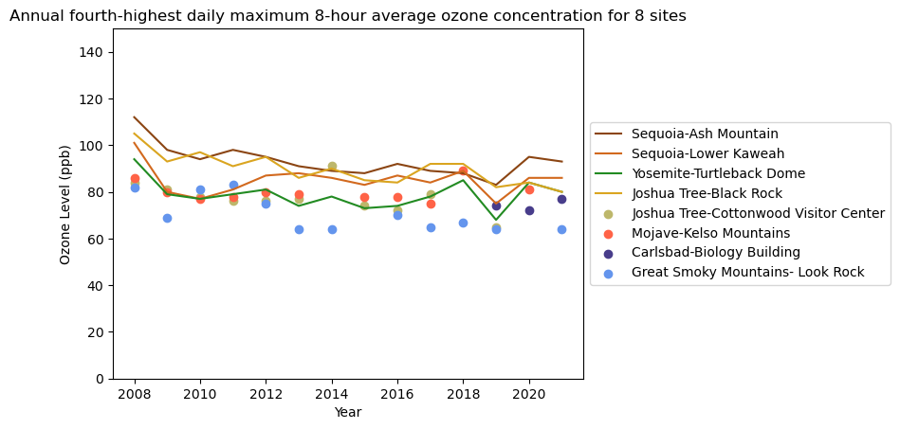

Slide 8
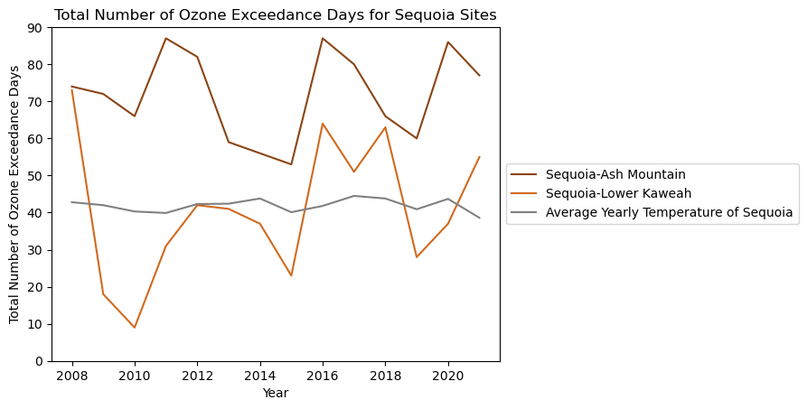

Slide 9
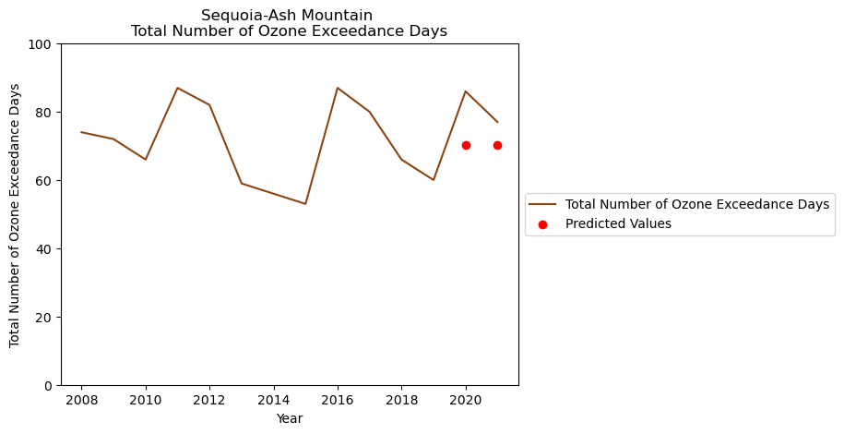
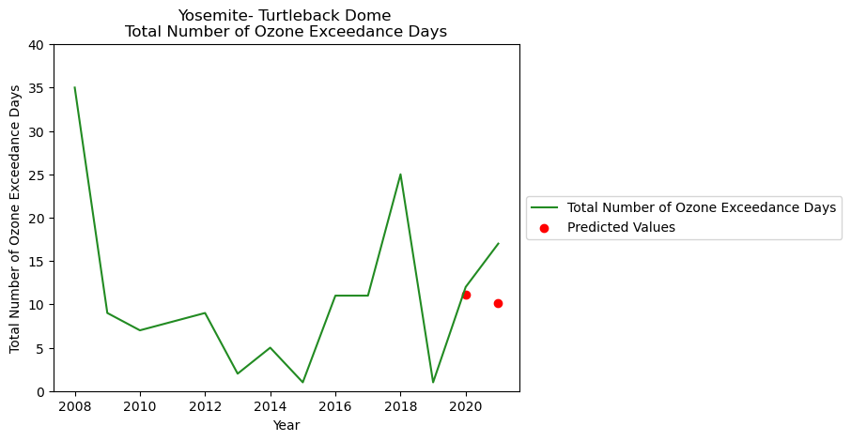
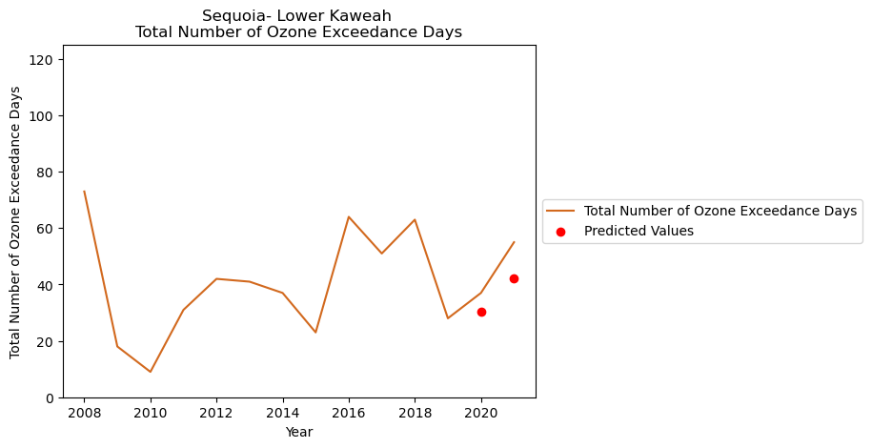
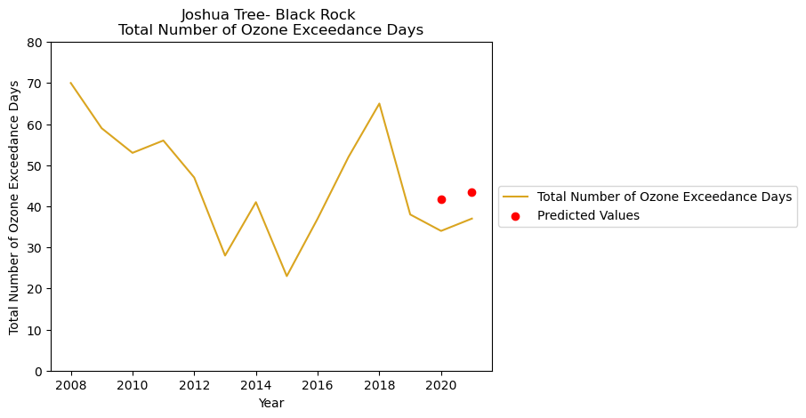

Slide 10
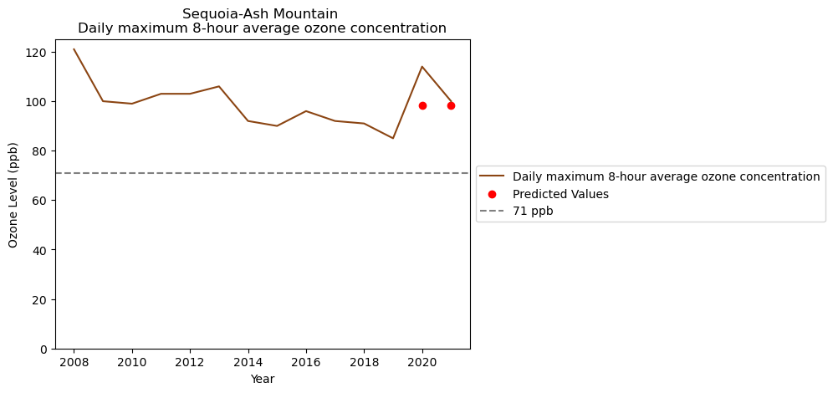
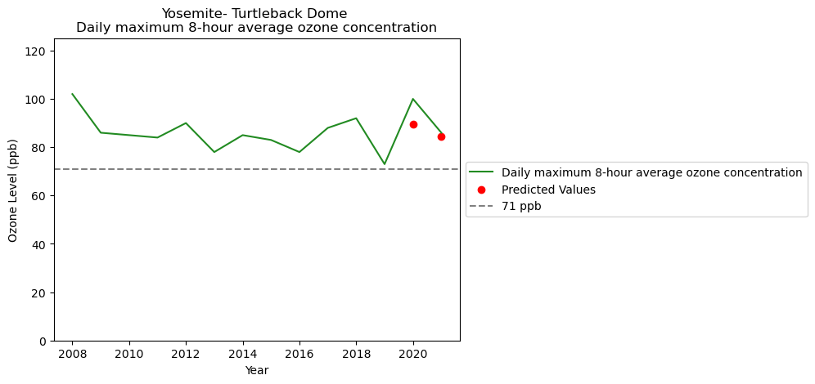
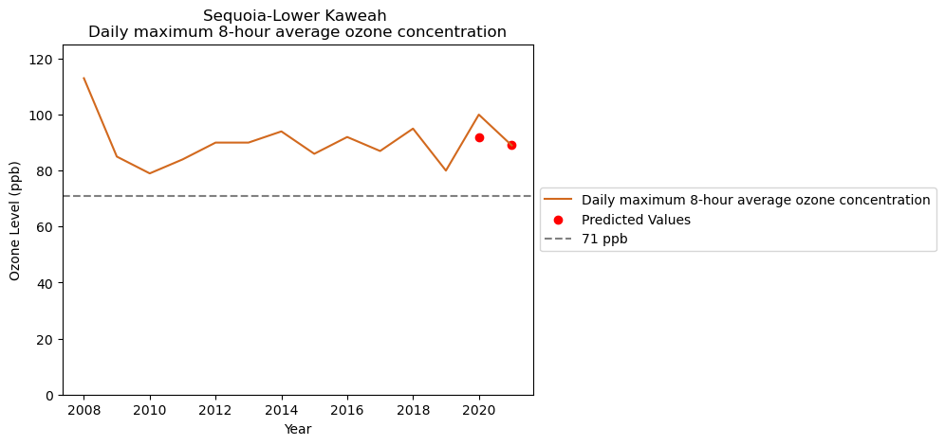
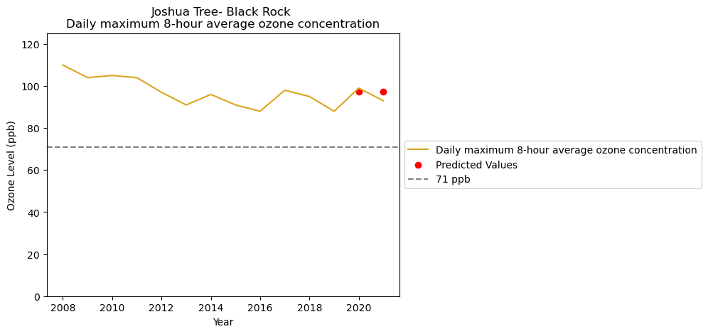

Slide 11
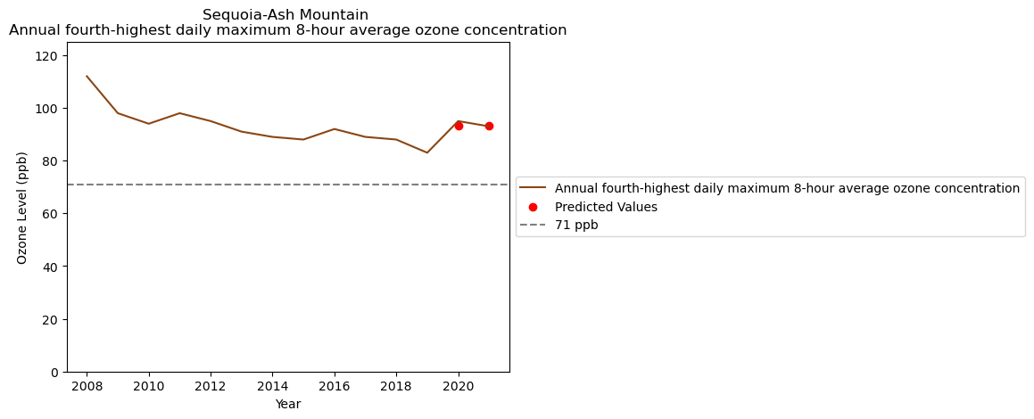
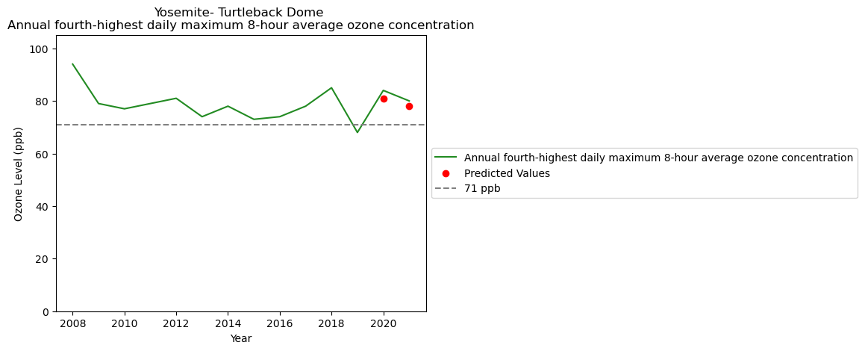
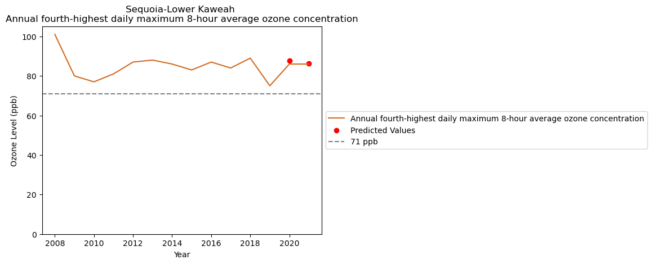
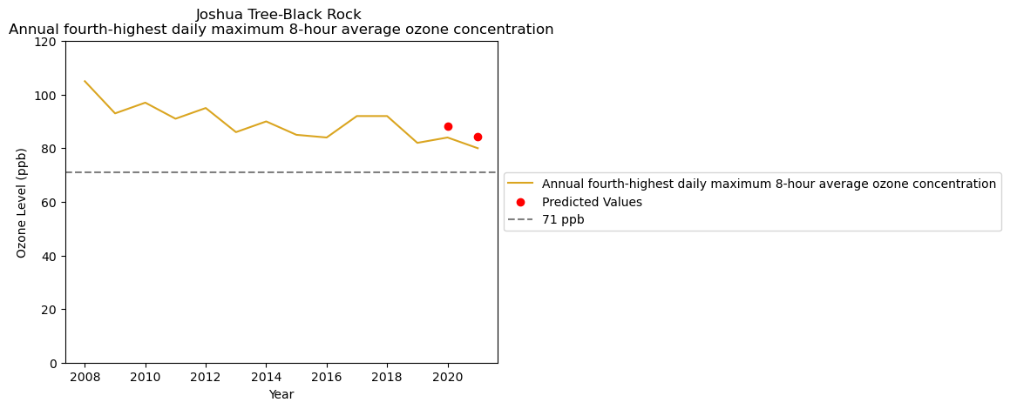

Slide 12
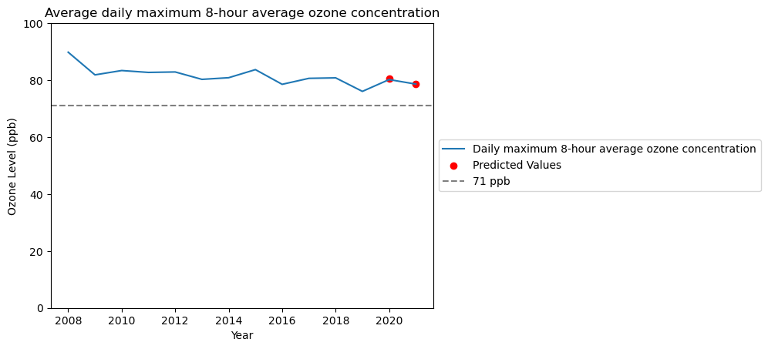
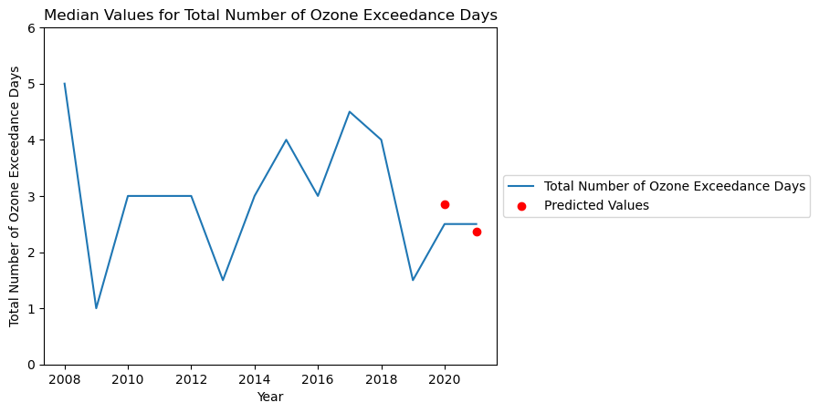
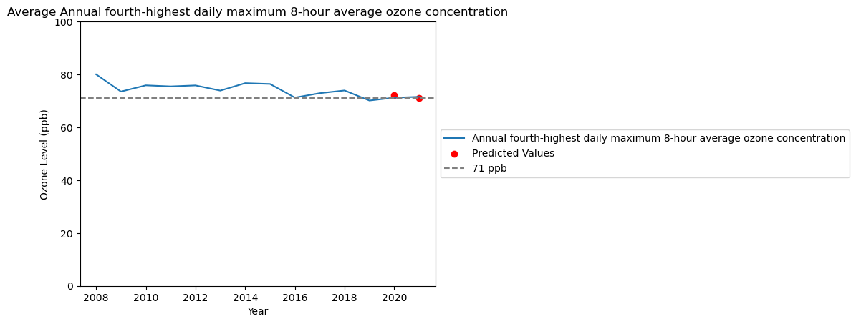

Slide 13
Conclusion
All models perform moderately well
Generalized models illustrate trends within the US
Limited by amount of data available
Ethical considerations include NPS’s responsibility to the nature it protects

Slide 14
References
Average temperature in Sequoia National Park by Year. Extreme Weather Watch. (n.d.). https://www.extremeweatherwatch.com/cities/sequoia-national-park/average- temperature-by-year
California Air Resources Board (n.d.). Health Effects of Ozone. Ozone & Health. https://ww2.arb.ca.gov/resources/ozone-and- health#:~:text=Ozone%20is%20formed%20in%20the,paints%2C%20and%20many%20o ther%20sources.
inderjalli. (2019, February 25). wmape_group_example.py. wmape_grouping. https://github.com/inderjalli/wmape_grouping/blob/master/wmape_group_example.py
National Park Service (n.d.). Ozone Standard Exceedances in National Parks. NPS DataStore. https://irma.nps.gov/DataStore/Collection/Profile/4319

